Slide 1
Object Oriented Programming with C++
Dr. YAN LI
Phone: 138 29707 421(M)
E-mail: yanlics@qq.com
Office: Room 411, Nanhai Building

Slide 2
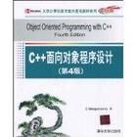
Text Book
Object Oriented Programming with C++
Fourth Edition
by E Balagurusamy
McGraw-Hill Press
清华大学出版社（影印版）

Slide 3
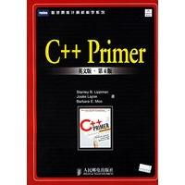

References:
Stanley B. Lippman, Josee Lajoie and barbara E. Moo, C++ Primer, 4th Edition.
“广博如四库全书”
Scott Meyers, Effective C++, 3rd Edition. Addison-Wesley Professional
（中文版：电子工业出版社）
“轻薄短小高密度的专家经验积累”

Slide 4
Grade distribution
Homework assignments: 10%
Attendance: 10%
Midterm exam:20%
Final exam: 60%

Slide 5
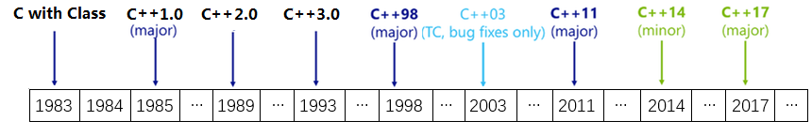
Chapt 2 Beginning with C++
  Early 1980’s，AT&T Bell laboritaries, Bjarne Stroustrup
  an extension of C with a major addition of the class construct feature.
  C++ support object oriented programming feature and still retain the power and elegance of C.
  C→ C with class → C++ → ANSI C++ → Modern C++
Revisions to the C++ Standard

Slide 6
C++: A federation of languages
C
C is the base of C++
Object-Oriented C++
C with classes: classes（类）, abstract and encapsulation（抽象和封装）,inheritance（继承）,polymorphism（多态）, virtual functions et al.
Template（模板） C++
Generic programming（泛型编程）
STL
Standard Template Library

Slide 7
C is Alive in C++
C++ is a superset of C.
Any correct C program is also a correct C++ program, except for some loopholes in C that are not allowed in C++.

Slide 8
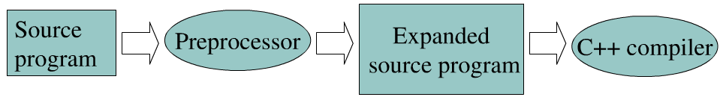
What is still the same
The syntax of statements
  if-else, switch, operators including the ternary operator “?:”
  for/while/do-while loops
  assignments
  arithmetic/logic/relational/ bitwise expressions
  declarations, struct/union/enum types, typedef
  pointers, arrays,
  casting
Same preprocessor commands in C &C++ （预处理命令）
  The preprocessor runs before any other compilation happens. The preprocessor is a program that acts as a filter during the compilation phase. Your source program passes through the preprocessor on its way to the compiler.
  Commands given to the preprocessor allow the programmer to do macro definition, perform text substitution, and test simple conditions.

Slide 9
A First Program
// Program: Display
// Author(s): Ima Programmer
// Date: 1/24/2001
#include <iostream> // include header file
using namespace std;
int main() {
cout << “C++ is better than C.”<<endl;
return 0;
}
Comments
Preprocessor
directives
Function named main() indicates start of program
Provides simple access
Ends executions
of main() which ends program
Insertion
statement
Function

Slide 10
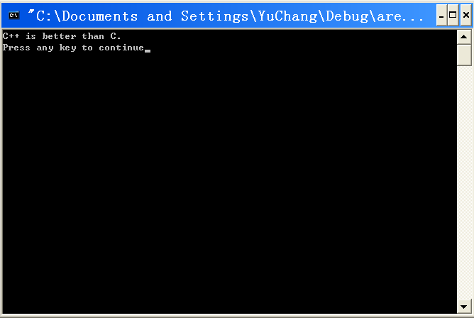
Program output

Slide 11
Comments
Allow prose or commentary to be included in program
Importance
  Programs are read far more often than they are written
  Programs need to be understood so that they can be maintained
Typical uses
  Identify program and who wrote it
  Record when program was written
  Add descriptions of modifications

Slide 12
Comments (Contd.)
C++ has two conventions for comments
  // single line comment (preferred)
  Anything from // to the end of line is considered a comment and thus ignored by the compiler.
  The C-syntax for comments, /* … */, can still be used for multi-line comments.
int i; // i is an integer that will index the next array
double x[10]; /* an array that will store user input
and will then be sorted. */
for(j=0; j<n; /*loops n times*/ j++)

Slide 13
The C++ Preprocessor
#include <iostream>
A line beginning with a pound sign(#) is called a preprocessor directive
The preprocessor expands an #include directive by physically inserting the contents of the named file into source program
A file whose name appears in an #include directive is called a header file
Header files contain constant, variable, data type,classes and function declarations needed by a program (no definitions)

Slide 14
In the C language the standard header files end in the suffix .h, where h suggests “header file”.
In ISO/ANSI C++, the standard library header files no longer use the .h suffix.
The header files written by users use the .h suffix.
#include “myheaderfile.h”
Type of header file | Rule | Examples
C style | With suffix .h | string.h, iostream.h
C++ style | Without suffix .h | string, iostream
Converted c style | With affix c and without suffix .h | cstring, cmath

Slide 15
Namespace
using namespace std;
C++ provides namespaces to prevent name conflicts.
Namespace defines a scope for the identifiers that are used in a program.
Namespace is the mechanism for supporting module programming paradigm (模块编程范式).

Slide 16
Namespace
using namespace std;
std is the namespace where identifiers in ANSI C++ standard libraries are declared.
Without the statement, compiler cannot recognize the identifiers cout and endl.

Slide 17
An identifier declared within a namespace block can be accessed directly only by statements within that block.
To access an identifier that is “hidden” inside a namespace, the programmer has several options. We describe two options here.

Slide 18
The first option is to use a qualified name for the identifier.
A qualified name consists of the name of the namespace, then the :: operator (the scope resolution operator), and the desired identifier:
std::cout
With this approach, our program looks like the following:
#include <iostream>
using namespace std;
int main() {
std::cout << “C++ is better than C.”<<std::endl;
return 0;
}

Slide 19
The second option is use a statement called a using directive:
using namespace std;
When we place this statement near the top of the program before the main() function, we make all identifiers in the std namespace accessible to our program without having to qualify them:
#include <iostream>
using namespace std;
int main() {
cout << “C++ is better than C.”<<endl;
return 0;
}

Slide 20
Output & Input
Instead of the complicated syntax of printf and scanf, C++ offers a much simpler syntax
For standard output, use cout
  cout is a predefined object of the standard output stream (ostream)
For standard input, use cin
  cin is a predefined object of the standard input stream (istream)
#include <iostream>
using namespace std;
Note: one can still use the IO syntax of C in C++

Slide 21
Cout
For printing output, use this syntax:
This prints out the string or the value of the expression.
For output chaining, use this syntax
Each S_{i} is a string or an expression. The effect is to print out the value of S₁ followed by the value of S₂, followed by the value of S₃.
cout << a string or an expression;
cout << S₁ <<S₂<<S₃<<endl;
cout << S₁ <<‘ ‘<<S₂<<‘ ‘<<S₃<<endl;

Slide 22
Cout (Examples)
Statements | Output
int x=3; double y =4.5; cout <<x; cout<<y; cout <<x+y;
int x=3; double y =4.5; cout <<“x = “<<x<<“\n”<<“y=“<<y; cout <<“\nx+y”<<x+y;
34.57.5
x = 3
y=4.5
x+y=7.5

Slide 23
Cout (Contd.)
The reserved word, endl, ensures that the next cout command prints its stuff on a new line.
cout<<x<<endl;
The identifier endl is a special C++ feature called a manipulator.
New lines can also be added using ‘\n’.

Slide 24
Cin
For reading input values into variables:
This reads the input from the standard input (say the keyboard for now), puts the first read value in variableName1, the second read value in variableName2, and the third read value in variableName3.
cin >> variableName1 >> variableName2 >> variableName3;

Slide 25
Cin (Examples)
Suppose you want to read an int value and a double value into variables n and x.
This code will do it (see next slide):
int n; double x;
cout<<“enter an int, a space, and a double: “;
cin>>n>>x; // use of cin
You enter: -3 9.8
You enter -39.8

Slide 26
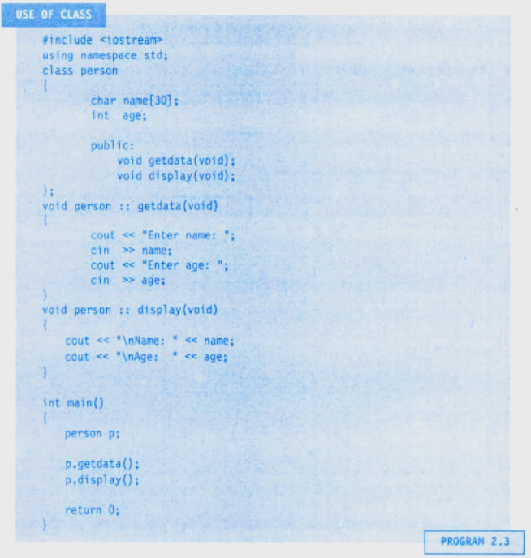
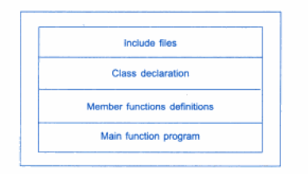
Structure of C++ program

